Slide 1
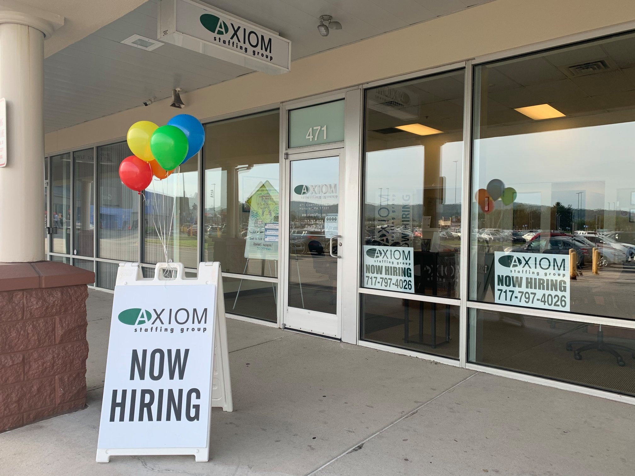
Axiom Staffing Group
471 Eisenhower, Dr. Hanover, PA. 17331

Slide 2
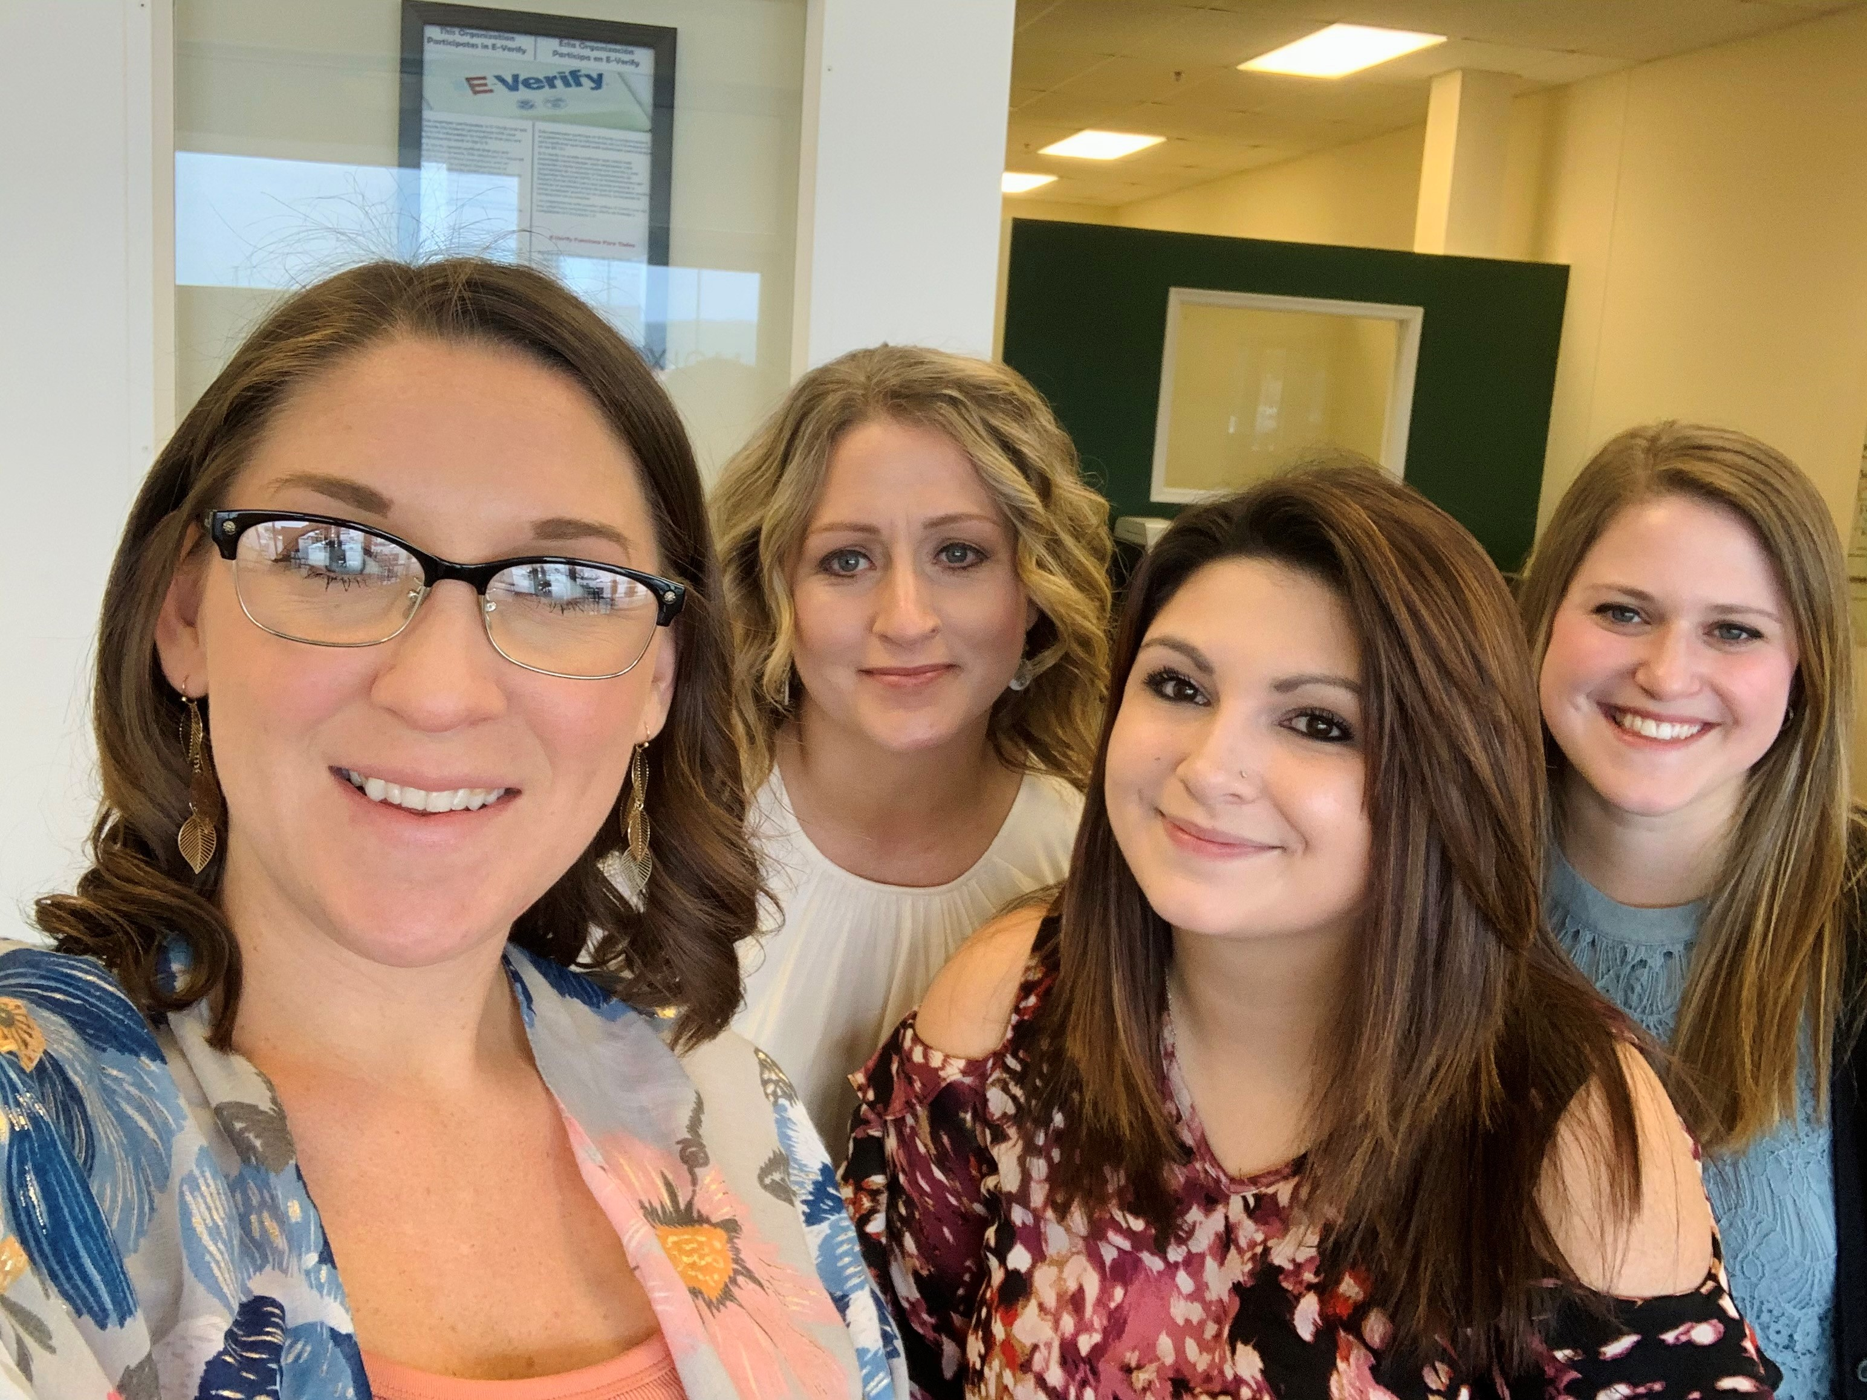
MEET OUR TEAM
JENN
4 years with Axiom
MEGAN
1 month with Axiom
MYA
9 months with Axiom
SKYLAR
3 years with Axiom

Slide 3

What is AXIOM?
A general description, would be that we are a staffing agency. We partner with local and out of state companies and provide employment opportunities for job seekers. However, Axiom strives to be more than an average temp service.
We are a universally recognized truth
Axiom has a vision that remains true to the timeless virtues of great businesses. Building alliances that are deep and lasting. Listening and being truly responsive. Growth matched by our commitment to personalizing the business.
We change with the times while remaining true to you, the customer, and ourselves.
That’s why we are AXIOM.

Slide 4
What kind of jobs does Axiom have?
We work with a variety of companies and industries including but not limited to the following:
Foundries- Metal grinding and blasting, machine operators, mold assemblers and more.
Lumber companies- Yard laborers, machine operators and assembly.
Tailoring Factory- Sewing, pressing, examiners, table workers and more.
Metal Fabrication- Welding, laser operators, press break and general shop.
Manufacturing- Picking and packing, assembly, quality control, general labor and more.
Logistics- Forklift, picking and packing, pallet jack, shipping and receiving and more.
Offices- Many of our warehouses and factories also offer entry level office work.
Food Production- Sanitation, line workers, machine operators, forklift operators and more.

Slide 5

Did you know that York County has become known as “Snack Food Capital of the World”?
Well, I didn’t until I started working for Axiom and partnering with some of the many food manufacturing businesses here in Hanover. Pretty cool!

Slide 6

Do I need experience for all these jobs?
No, some of our more skilled positions do require experience but we also have countless opportunities that are entry level and willing to train.
Therefore, a staffing agency is a great way to get your foot in the door somewhere, and it could lead to big things for your future and career.
You do however have to be 18 or older to work with Axiom, but once you are, we can work with you that same day!

Slide 7

What is the process?
To get set up with us, you get registered into our system online. You can do this from home or in our office. Once that is complete, we will go through an interview with you to see what position would be the best fit. After an employment decision is made, there is a couple more computer steps and paperwork depending on the client.
Some clients will interview you directly, and others we can just get you confirmed to start work.
Typically, the process is very easy, and we aim to get you to work as fast as you are looking to.

Slide 8



Do people have success with an agency?
Yes! Below are just a few of our many success stories.
Victoria was working with us at a Tailoring Factory in Westminster, MD. and was hired on to the client. Since day one, she has loved her job, and her hard work paid off!
Meghan was working with us at a Logistics company as a Customer Service Rep. and was hired on in just 3 short months. Way to go Meghan!
Steven was working with us for a while on many assignments, then he finally found one that he loved, his dedication paid off and he was hired on the client.

Slide 9
I’m planning on going away for college, why would I want to work with Axiom?
We don’t just have long term, temp to hire assignments, we have temp only too!
We get one day assignments, as well as seasonal work if you are home visiting from college or on a holiday break.
We have one client that has a two-week assignment once EVERY month!
This is why it is important to be registered with us so you can receive alerts for all of the different openings we get.

Slide 10



Apply online at https://hrcenter.tempworks.io/en/axiomstaffing/ and we will call you for a phone interview.
Call 717 797 4026 with questions.
We are accepting walk-ins Mon-Fri from 9am-2pm
471 Eisenhower Dr., Hanover, PA. 17331
Can't make it to Hanover? Ask us about our York interviews!

